Slide 1
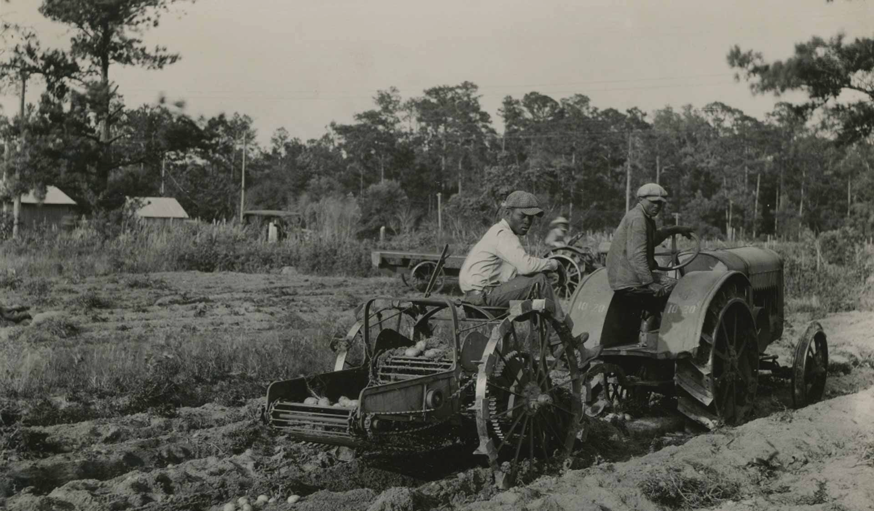

Trends in Yields of U.S. Crops and
Long-Term Selection
William F. Tracy
Department of Agronomy

Slide 2
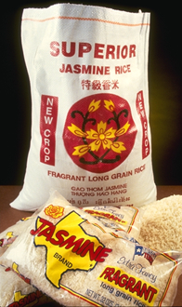
Long Term Trends in U.S. Crop Yields
Many measures of improvement
  Yield
  Quality
  Stress resistance
  Efficiency
Yield
  Comparable
  Data available
  USDA statistics

Slide 3
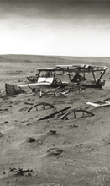
National statistics reflect changes due to shifts in;
management
climate
growing regions
genetics

Slide 4
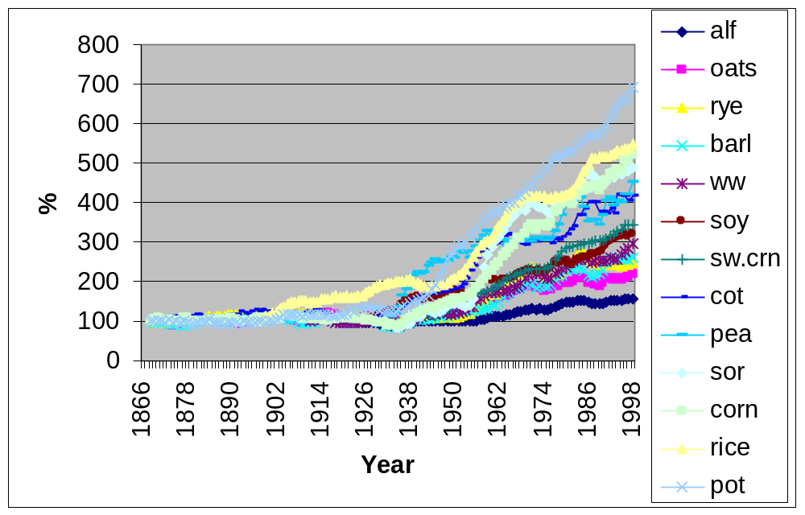
Changes in yield per area for 13 crops
(% of the mean of the first 5 yr)

Slide 5
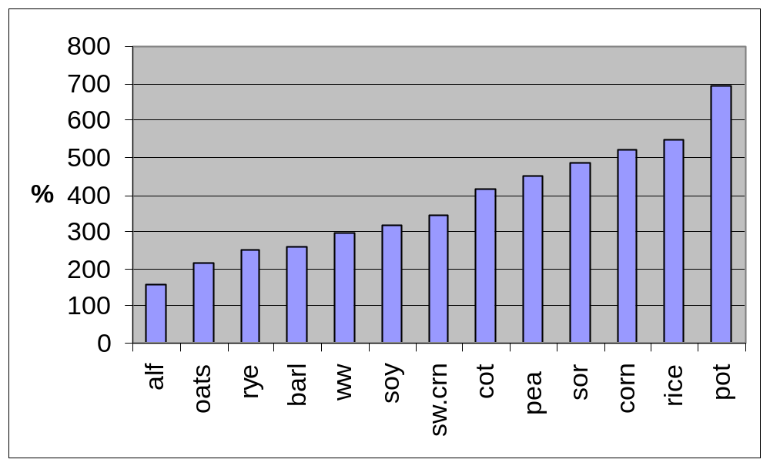
Increase in yield per area (% of first 5 years)

Slide 6
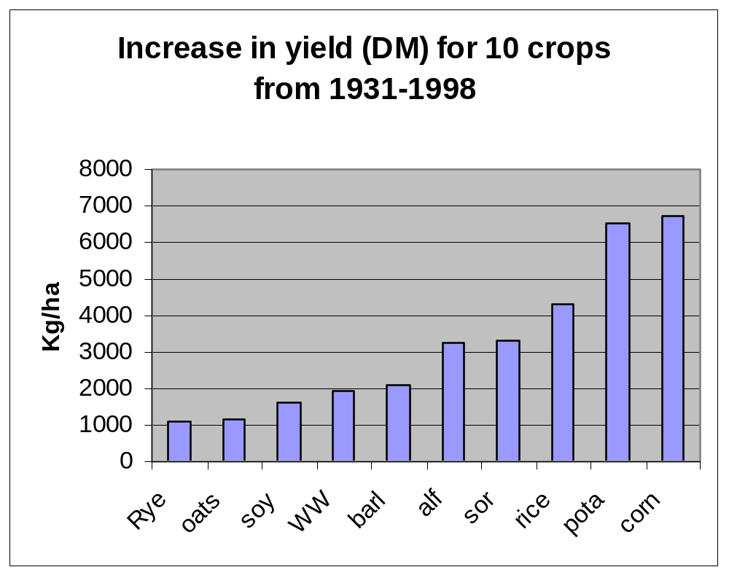

Slide 7
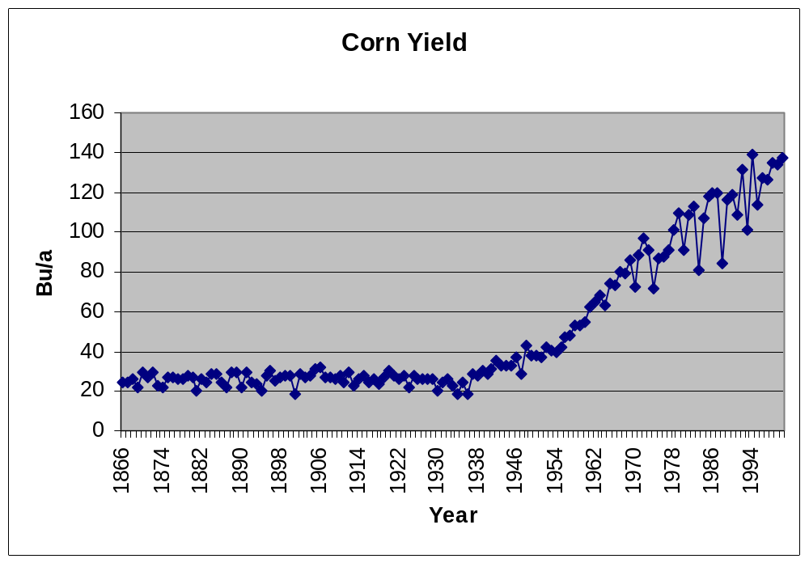

Slide 8
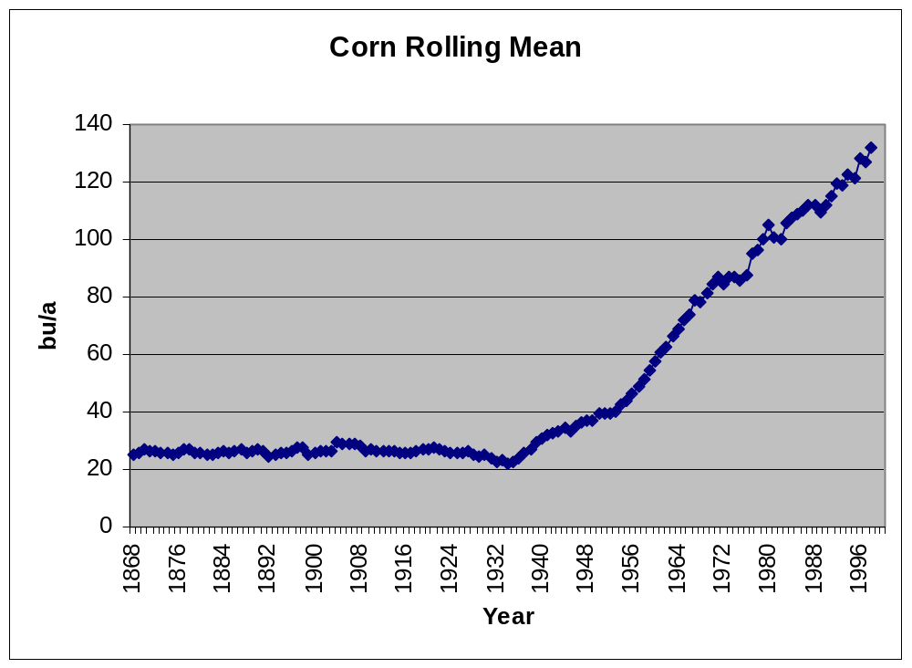

Slide 9
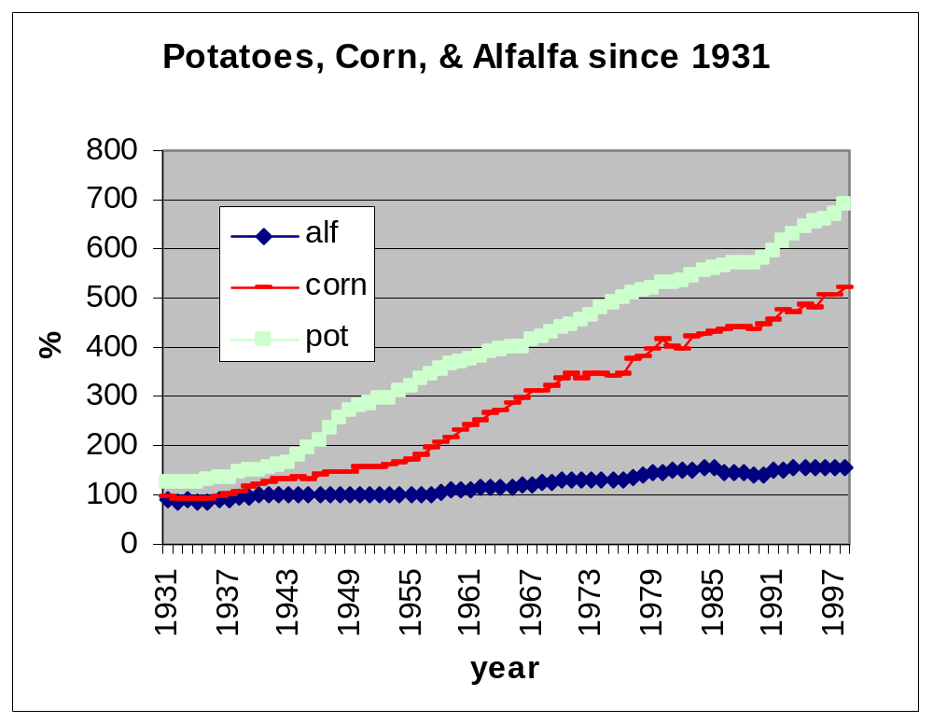

Slide 10
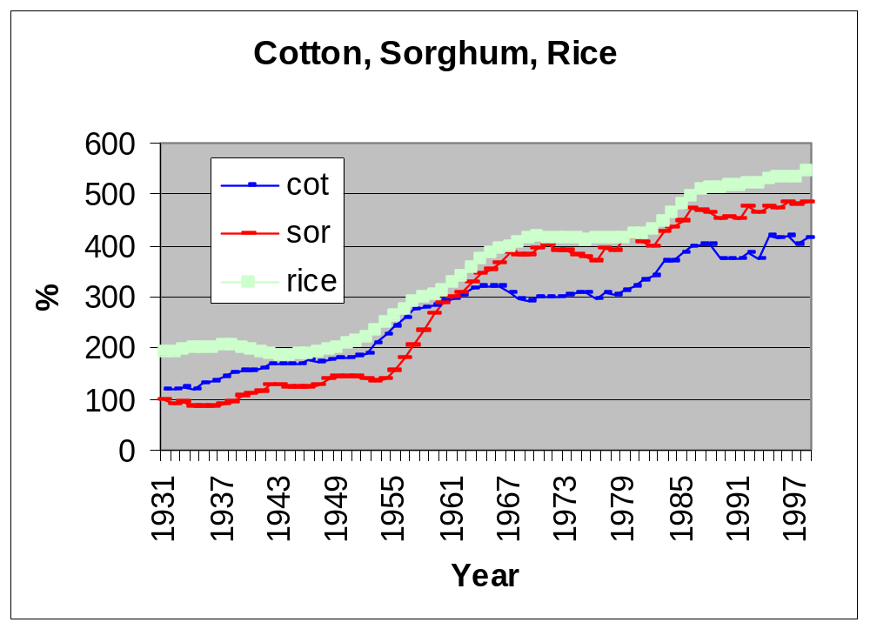

Slide 11
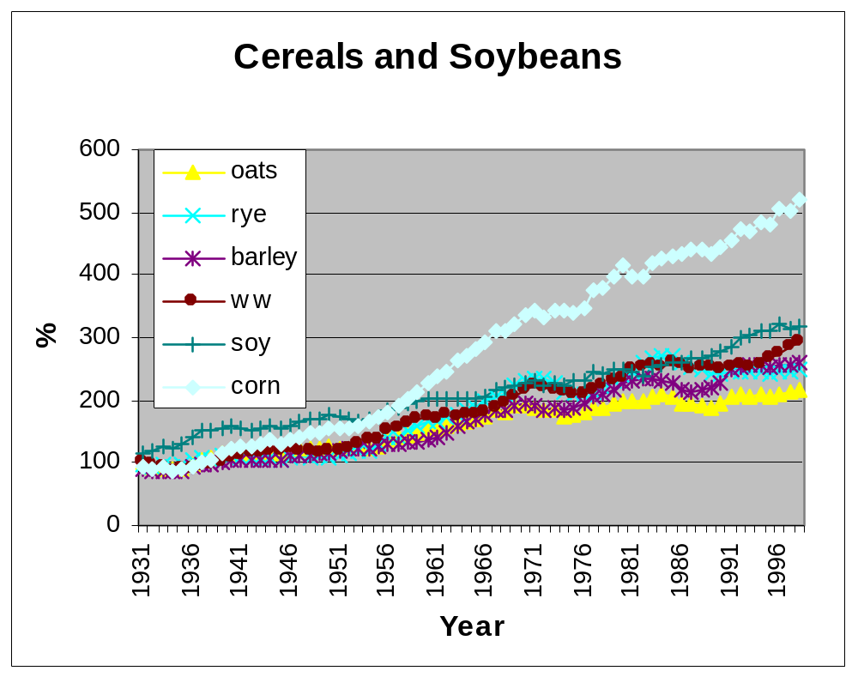

Slide 12
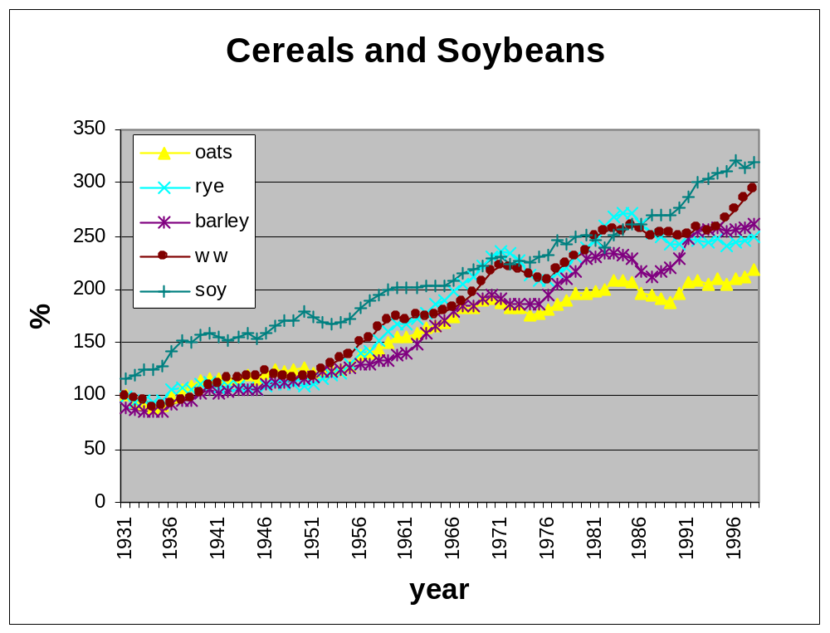

Slide 13
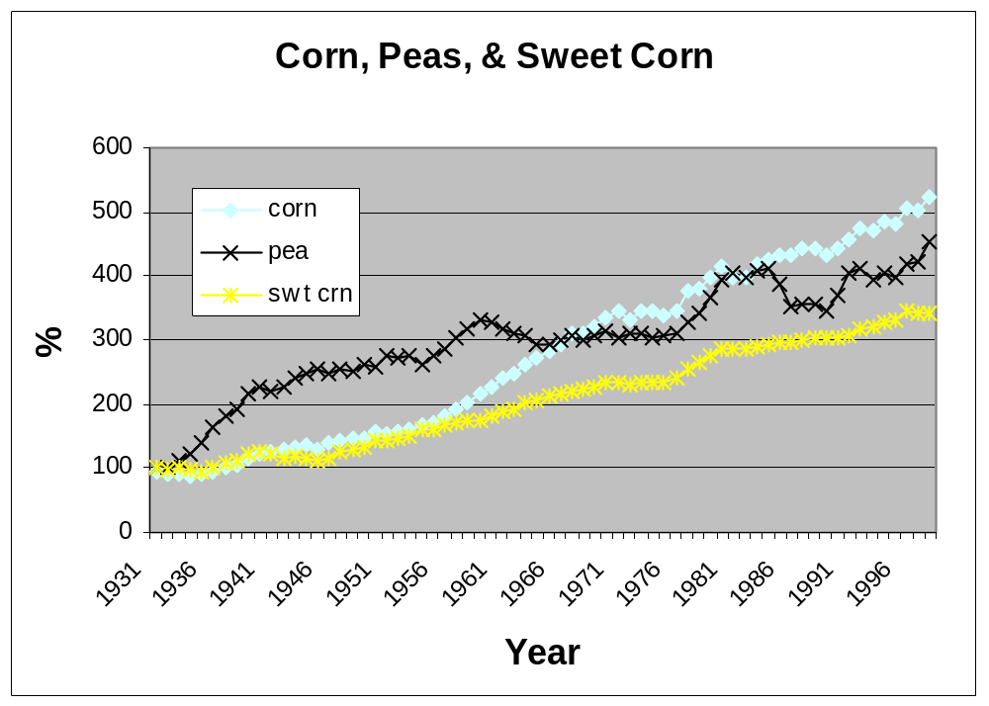

Slide 14
Has Variation in Productivity Increased Over Time?

Slide 15
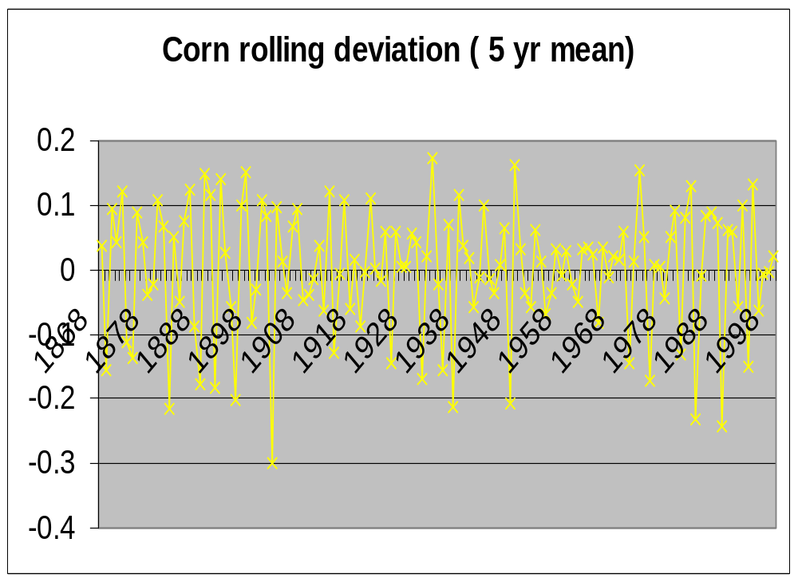

Slide 16
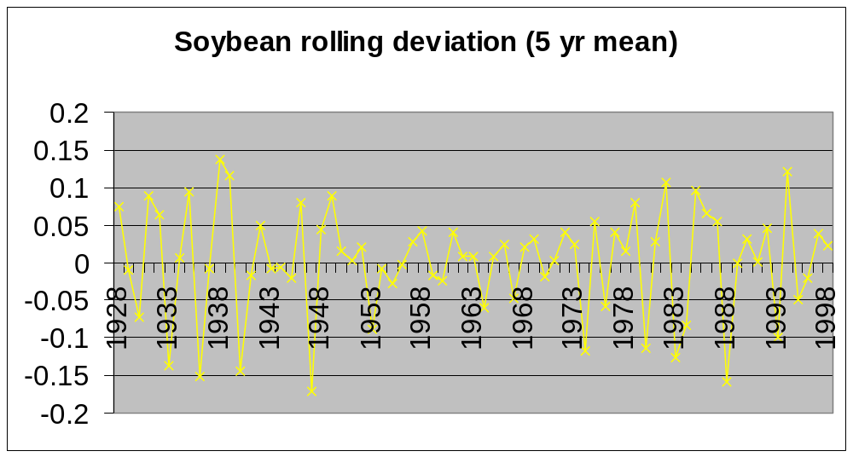

Slide 17
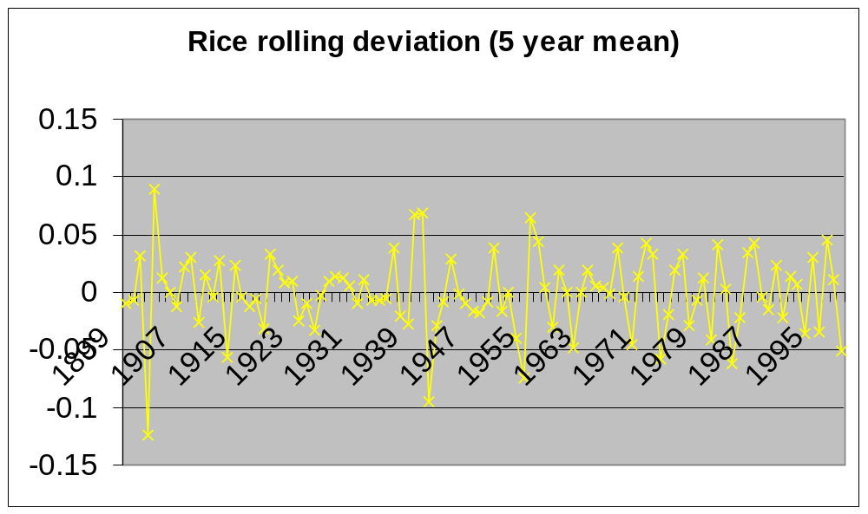

Slide 18
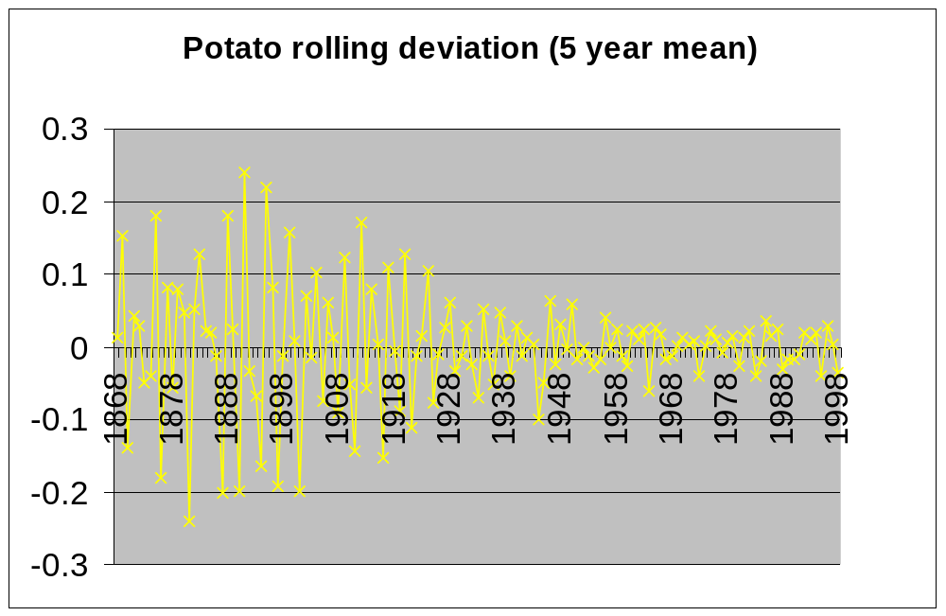

Slide 19
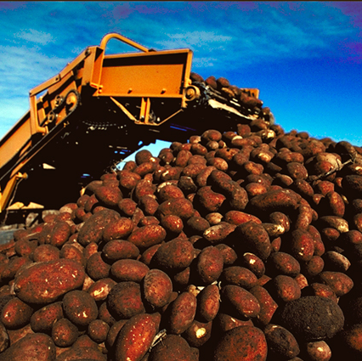
U.S. Crop Yields
For most crops yield / area increasing over time
Factors
  Management
  Shifts in growing region
  Genetic change
    Long term selection?

Slide 20
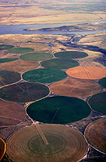
Management
Irrigation
Mineral Nutrition
Spacing and population
Pest control
Increased precision of equipment

Slide 21
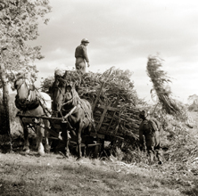
How much of this gain is due to genetic improvement
Most crops are not well documented
Corn - many studies
  Castelberry et al
  Duvick
  Russell
  others
Corn 50% (30-70%)

Slide 22
Other Crops
Wheat (USA)
  Schmidt 1984 >50%
  Austin UK 1999 ?
  Reynolds et al. 1999 CIMMYT
Soybean
  Specht et al. 1999
  >50%
Barley
  Rasmussen
Cotton
  Bridges and Meredith 1984
Rice IRRI
  Peng et al. 1999
  No gain in IRRI rice since IR8
Potato
  Douches et al. 1996

Slide 23
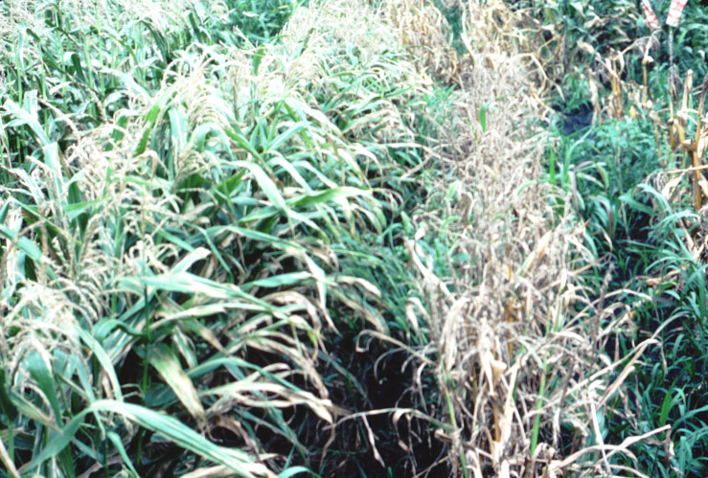
Selection Criteria Affecting Yield
Yield
Pest resistance
Response to inputs
Altered morphology
Altered phenology

Slide 24
High Input Agriculture
  Inputs
High levels of N
High populations
Irrigation
Results
Increased yield
Increased lodging
Increased pest pressure

Slide 25
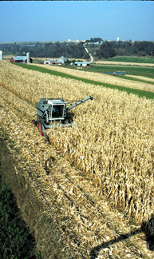
Strategies
Corn
increased stalk strength, modified leaf angle.
Stress resistance due to selection at high densities
Pest resistance found within elite pool

Slide 26
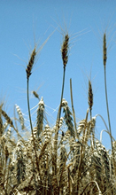
Alternate Strategies
Small grains, sorghum, and others
Stalk lodging
  Dwarf genes
Pest resistance
  Single gene systems
Yield and quality
  Quantitative traits

Slide 27
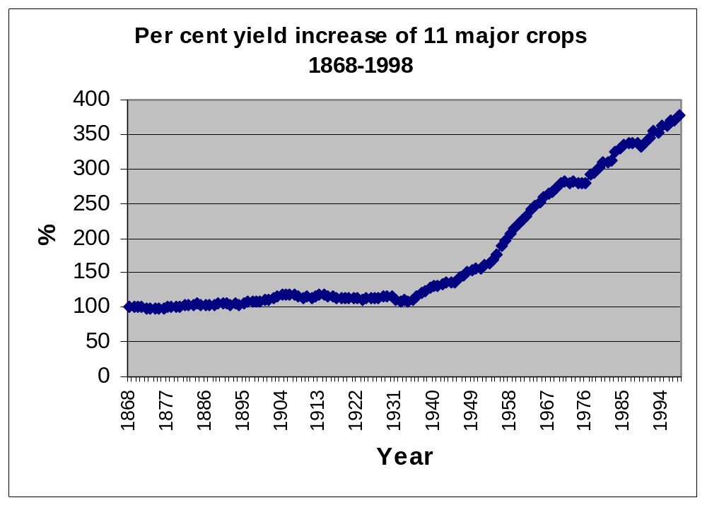
What can be attributed to long-term selection?

Slide 28
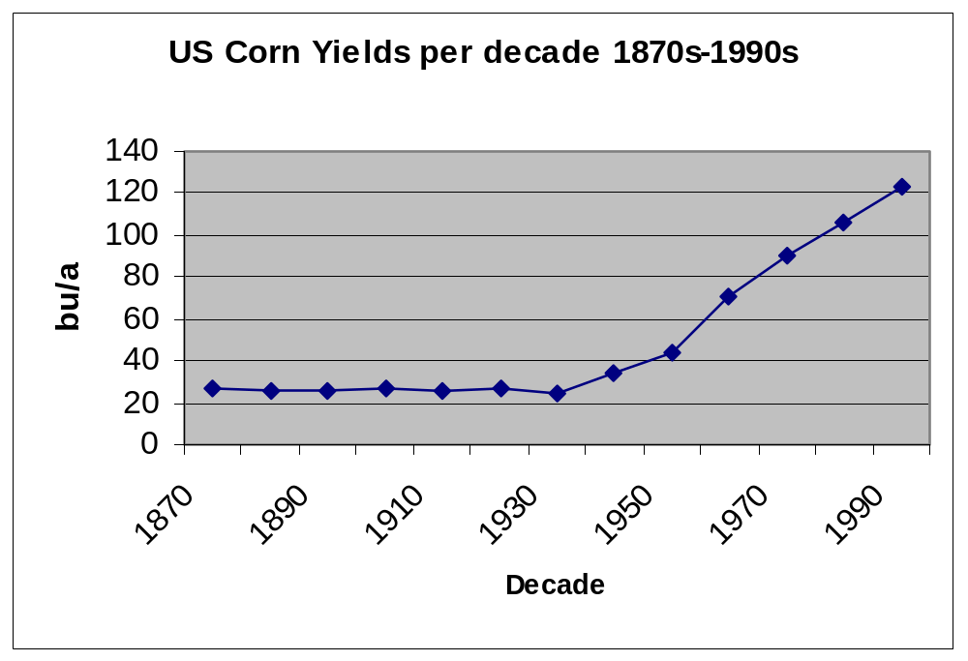
Long -Term Selection
Consistent selection criteria
Repeated over many generations
No (low) migration
Are these characteristic of most cultivar development programs?

Slide 29
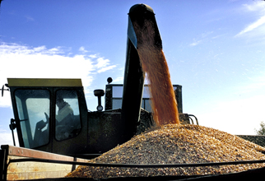
Corn
Most breeders select for same parameter (harvestable yield)
Most elite germplasm available recycled
Resistance found within elite pool
Studies show pattern of long-term selection

Slide 30
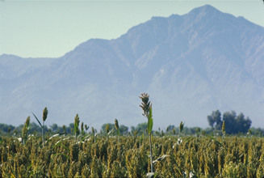
Many other crops
Generally want to stay within elite pool for quality
Select for yield
Often forced to leave elite material for pest resistance or morphological change
Backcrossing

Slide 31
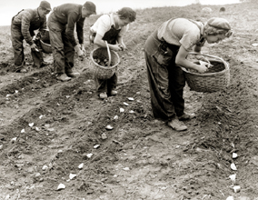
Potato
Yield increases not due to selection. (Douches et al 1996)
Selection has emphasized
  Earliness
  Quality
  Pest resistance

Slide 32
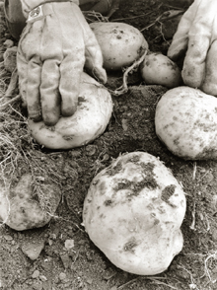
Potato
Very old varieties still being grown.
How can they handle high input agriculture?
Stalk strength in response to high N not a factor

Slide 33
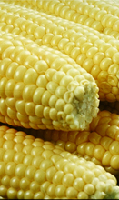
Sweet Corn and Other Vegetables
Each breeder has a distinct ideotype and selects for that objective.
May use competitors germplasm (F1 hybrids) but then pursue a distinct objective

Slide 34
Long Term Selection in Crops
Underutilized in many crops?
Demonstrated potential
Can cyclic approaches be designed that can avoid backcrossing but maintain acceptable levels of resistance in self-pollinated crops?
How can long-term selection and transgenic approaches be integrated?

Slide 35
Trends in Yields of U.S. Crops and
Long-Term Selection
Thanks to Irwin Goldman, Maggie Schaber,
Alison Tiefenthaler, and Jim Coors
William F. Tracy
Department of Agronomy

